Slide 1


cybersafe campus
LEARN, PLAY AND STAY SAFE ONLINE

Slide 2

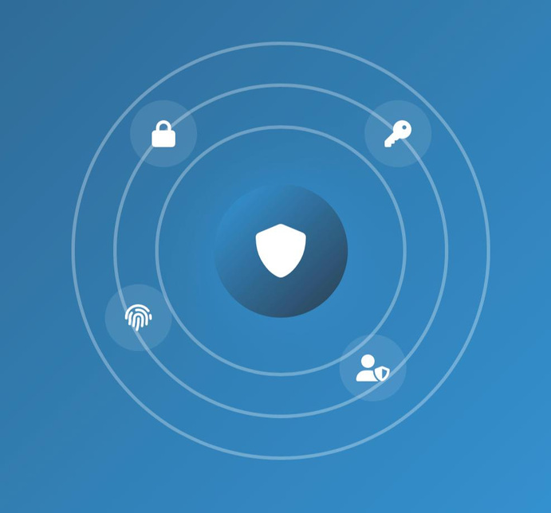
Agenda
Introduction
Problem
Why Awareness Matters
Objective & Goals
Our Solution
Common Type of Threats
Common Impacts of Cyber Threats
How to Stay Safe Online

Slide 3
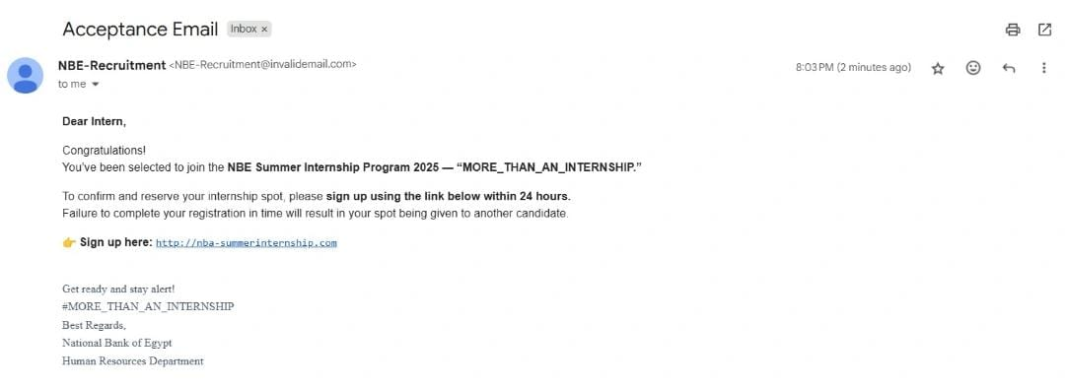

Slide 4
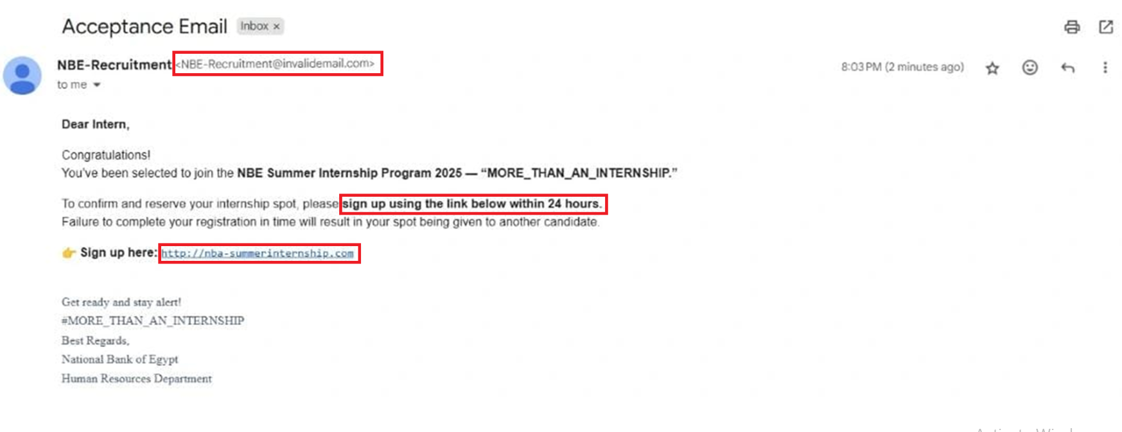

Slide 5
Introduction
Cybersecurity is about protecting systems, networks, and personal data from digital threats. But just like every good thing has a bad side, some people use technology to create cyber threats that attack others — and these threats are more dangerous than ever. A single careless click can expose private information or cause serious harm.
That’s why learning how to protect yourself online isn’t optional anymore. It’s a must for everyone.

Slide 6
Problem
Growing Cyber Threats
Unengaging Awareness Programs
Lack of Risk Awareness
Students face increasing risks from hacking, scams, and data breaches that endanger their privacy and personal information.
Existing cybersecurity programs are often dull or technical, failing to capture students’ attention.
Many students don’t recognize threats like phishing, scams, or data theft until it’s too late.

Slide 7

Why Awareness Matters
Most cyber incidents start with human error.
Builds safer digital behavior among us.
Protects personal and campus data.
Awareness = Prevention

Slide 8
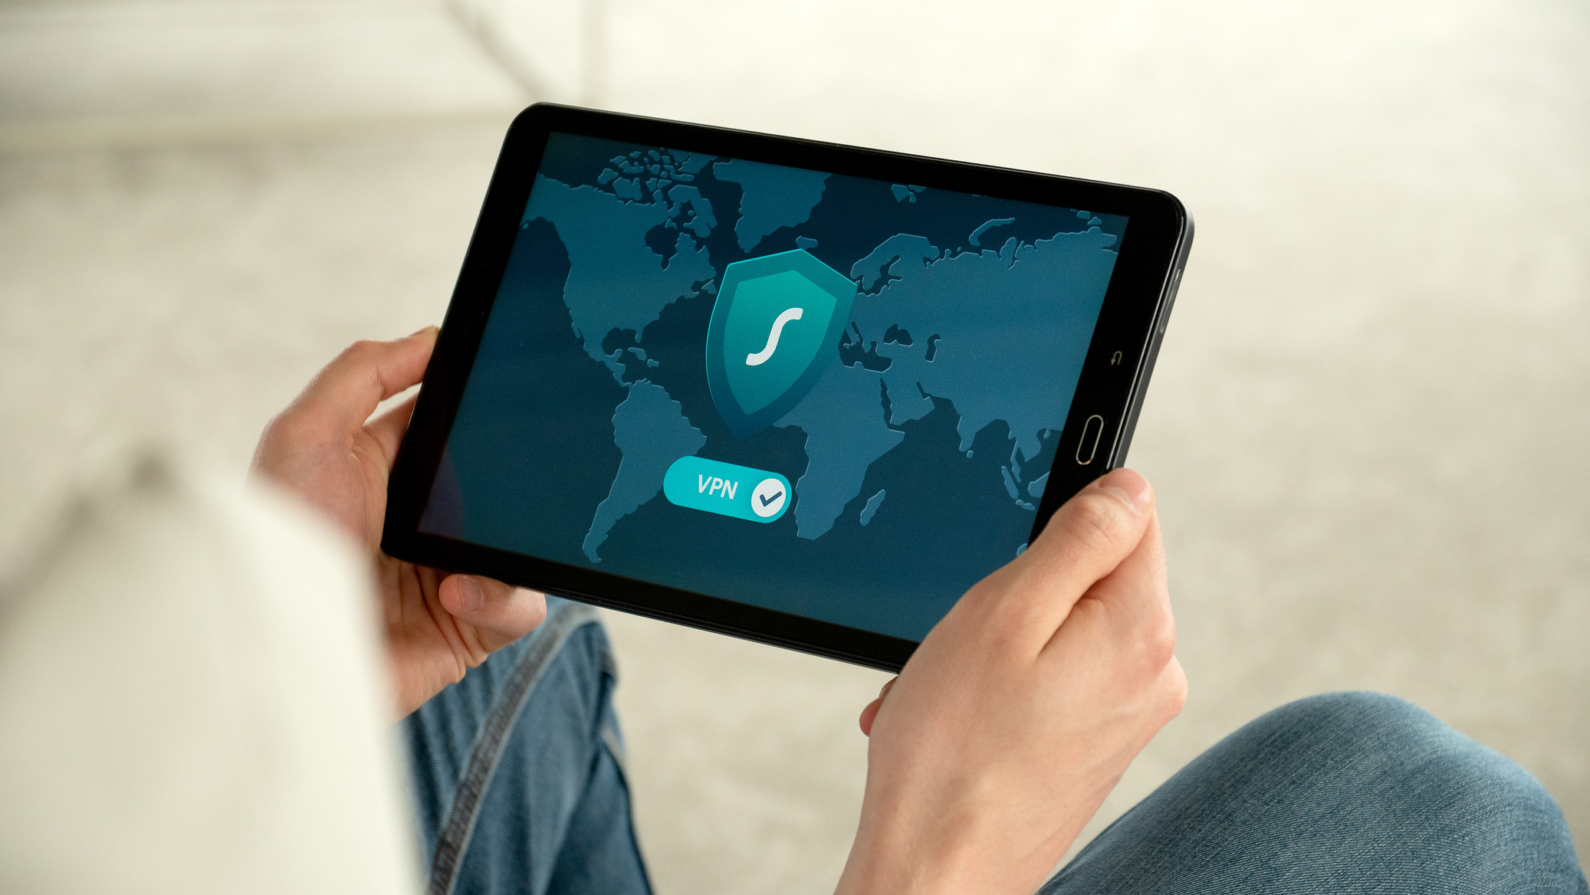

Our Goal
Our goal is to make cybersecurity learning fun and easy for students. By using gamification, we aim to keep them motivated and engaged throughout the learning process. This approach helps encourage safe digital habits across the entire campus community.

Slide 9

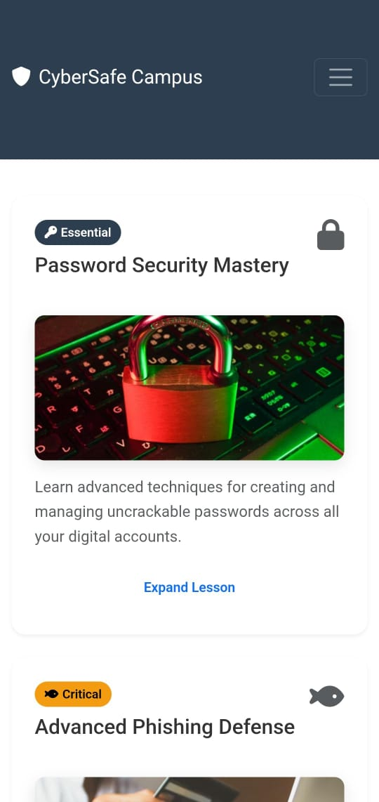
Our solution
Our solution is a website that raises cybersecurity awareness through gamified learning. It includes lessons, quizzes, and scoring systems to make learning enjoyable and motivating. The platform is interactive, engaging, and student-friendly, encouraging safe online behavior across campus.

Slide 10
Common Types of Threats:
Phishing
Password Threats / Credential Attacks
Network Threats
Malware Attacks
Social Engineering
Identity theft

Slide 11

Common Impacts
of Cyber Attacks
Loss of personal or financial data
Hacked or stolen social media accounts
Identity theft and online fraud
Damage to reputation or privacy
Emotional stress or embarrassment
Disruption to studies or daily life
Even a single careless click can cause serious harm

Slide 12
Avoid suspicious links and unknown senders and verify messages before clicking or replying.
Check for fast responses or mistakes like GO0GLE instead of GOOGLE using α instead of a, ü instead of u etc...
How to Stay Safe Online
Use strong, unique passwords with 2FA/MFA and never share your passwords.
Stay off public Wi-Fi for logins or file sharing and keep your firewall and antivirus always on.

Slide 13
Don’t download from unknown sources and always update your software regularly.
Scan files and USBs before opening and check your accounts often.
How to Stay Safe Online
Avoid oversharing personal details, keep your information private and use social media privacy settings.
Stay alert for emotional tricks and always verify before trusting.

Slide 14


Cybersecurity is not just a technical issue; it’s a human one.
Conclusion
Awareness is the first step toward protection.
Stay alert. Stay smart. Stay safe online.

Slide 15
Thank you

